Slide 1

Frito Lay Employee Attrition Review
Lani Lewis
SMU | 2023

Slide 2

“Nourishing a diverse workplace”
“Purpose-driven work”
“55,000 dedicated Frito-Lay employees”
“Competitive Pay”
“Excellent Benefits”
https://www.fritolayemployment.com/

Slide 3
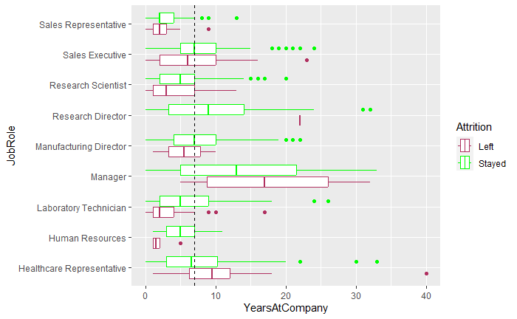
Longevity of Frito Lay Employees by Job Role
7-Year Average

Slide 4
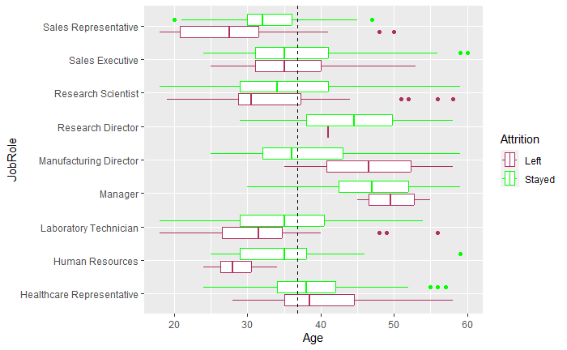
Age Matters
Average Age is 37

Slide 5
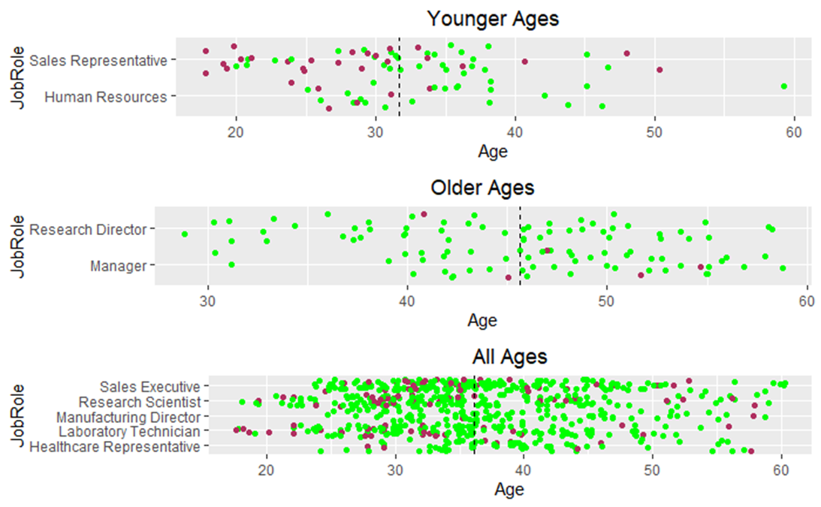
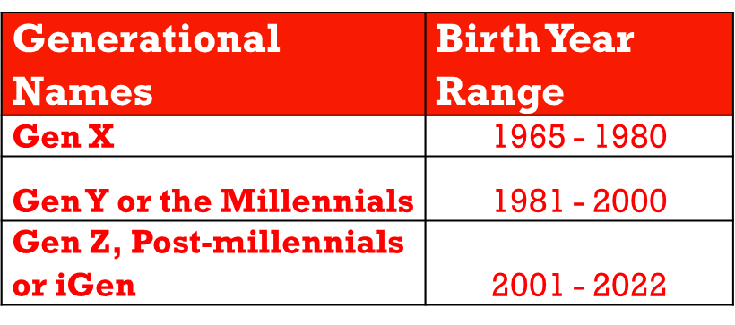
Generational Understanding
https://marketingartfully.com/customer-demographics-age-ranges-numbers/

Slide 6
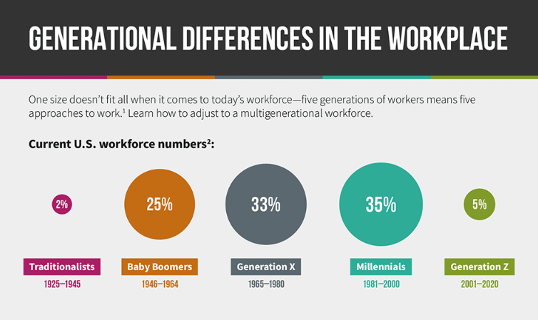
Generational Understanding
https://www.purdueglobal.edu/education-partnerships/generational-workforce-differences-infographic/

Slide 7
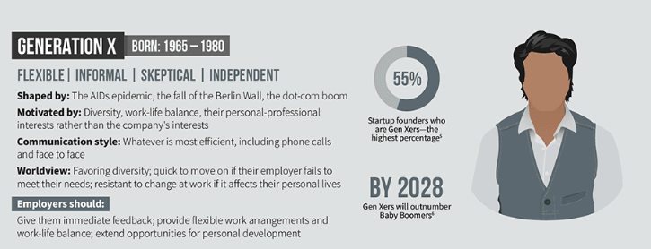
Generation X | 1965 - 1980
https://www.purdueglobal.edu/education-partnerships/generational-workforce-differences-infographic/

Slide 8
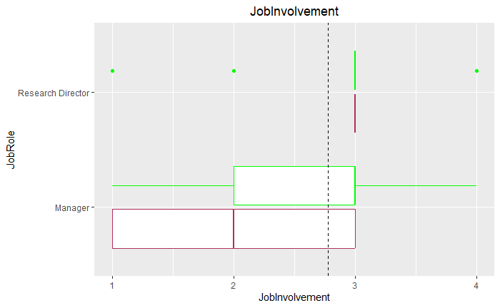
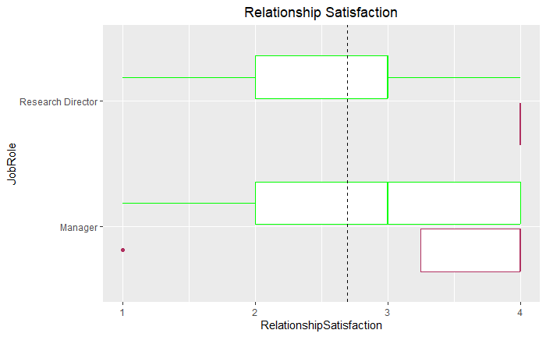
Generation X | 1965 - 1980
Career is part of their identity
https://www.shrm.org/resourcesandtools/hr-topics/global-hr/pages/generational-mindsets-affect-workforce.aspx

Slide 9
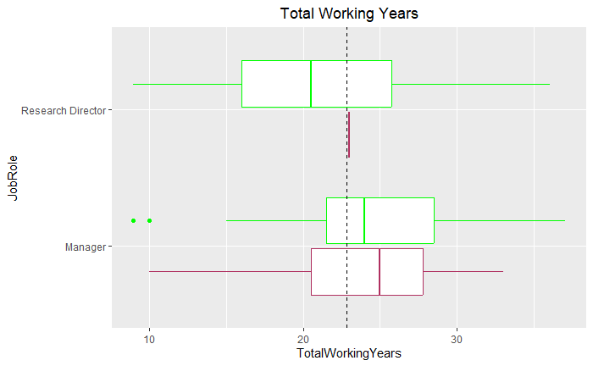
Generation X | 1965 - 1980

Slide 10
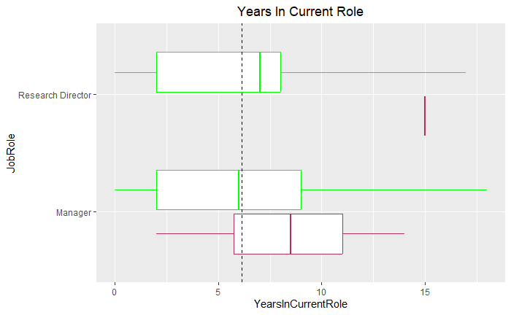
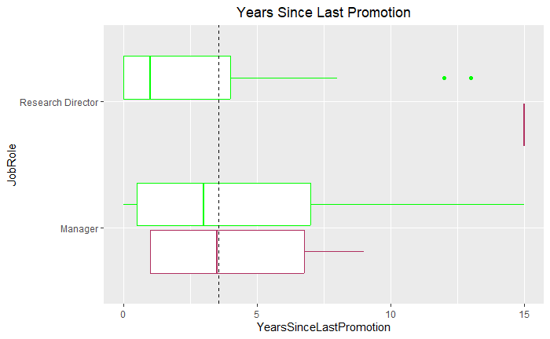
Generation X | 1965 - 1980
Expect their competence and skills to be respected
Avoid Burnout
https://www.shrm.org/resourcesandtools/hr-topics/global-hr/pages/generational-mindsets-affect-workforce.aspx

Slide 11
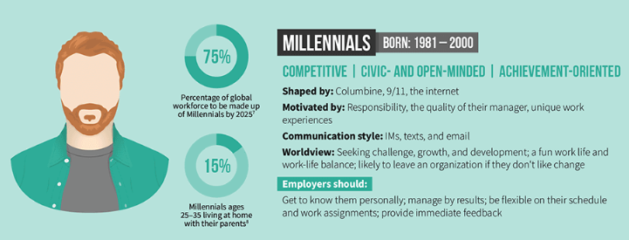
Millennials | 1981 to 2000
https://www.purdueglobal.edu/education-partnerships/generational-workforce-differences-infographic/

Slide 12
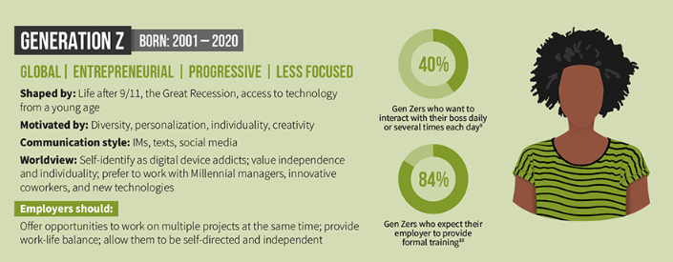
Generation Z | 2001 to 2020
https://www.purdueglobal.edu/education-partnerships/generational-workforce-differences-infographic/

Slide 13
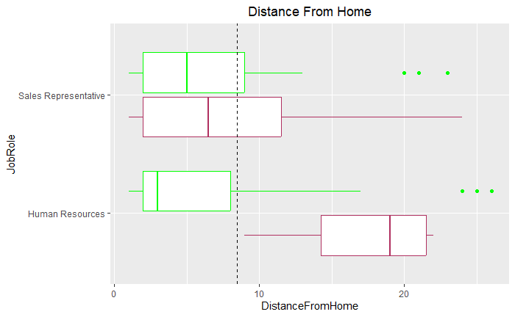
Millennials | 1981 to 2000 & Generation Z | 2001 to 2020
Work From Home Options
https://www.shrm.org/resourcesandtools/hr-topics/global-hr/pages/generational-mindsets-affect-workforce.aspx

Slide 14
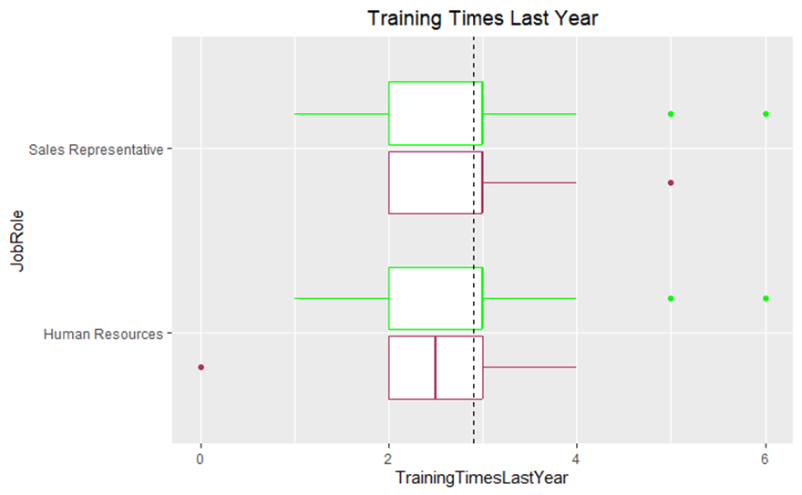
Millennials | 1981 to 2000 & Generation Z | 2001 to 2020
“Loyal to Colleagues”

Slide 15
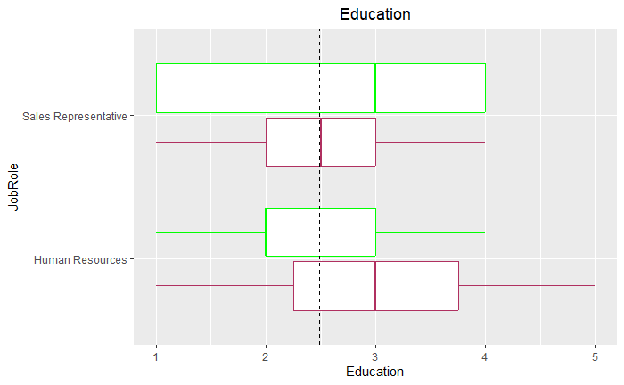
Millennials | 1981 to 2000 & Generation Z | 2001 to 2020

Slide 16
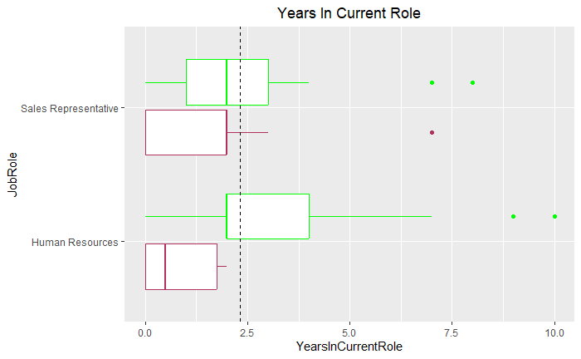
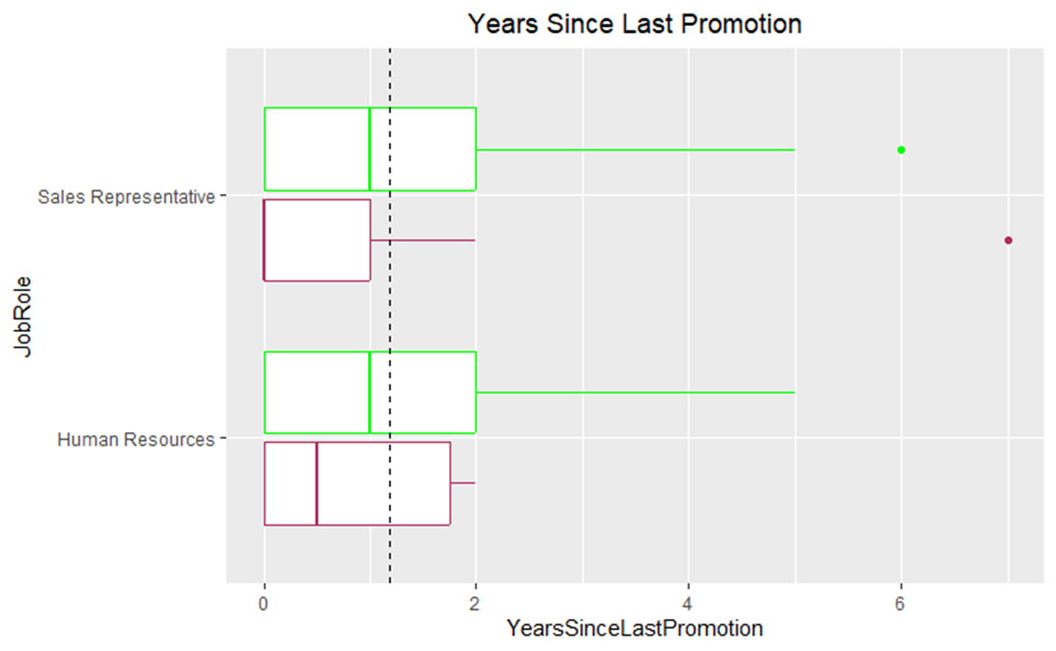
Millennials | 1981 to 2000 & Generation Z | 2001 to 2020
Growth is Key

Slide 17
Generation X | 1965 - 1980
Expect their competence and skills to be respected
Avoid Burnout
https://www.shrm.org/resourcesandtools/hr-topics/global-hr/pages/generational-mindsets-affect-workforce.aspx

Slide 18
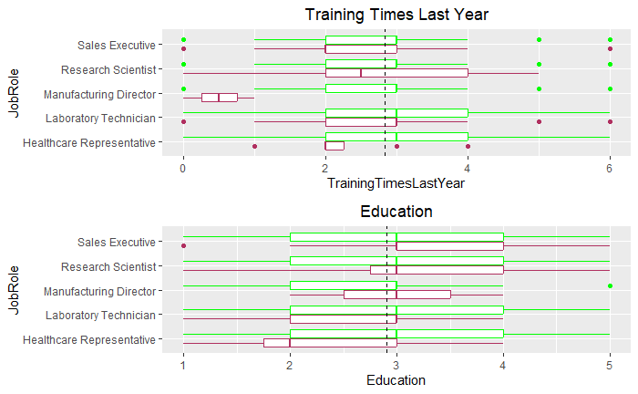
Mixed Generational Job Role Review
Education and Training

Slide 19
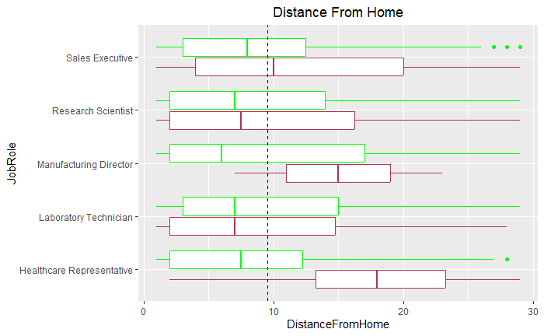
Mixed Generational Job Role Review
Work From Home Options

Slide 20
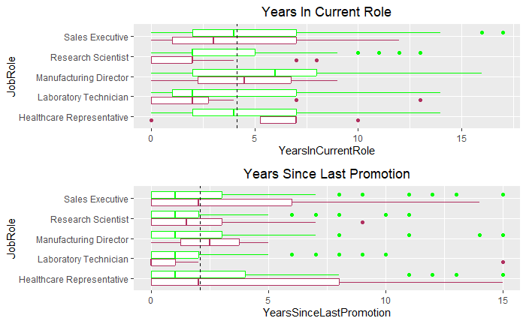
Mixed Generational Job Role Review
Foster Growth

Slide 21
Conclusion

Slide 22
Generation X | 1965 - 1980
Build Relationships
Growth Options
Work Life Balance

Slide 23
Millennials | 1981 to 2000
Want to be “apart” of the change!
“More then a Number”
Up and Coming Managers
Welcome Challenges and Personal Development

Slide 24
Generation Z | 2001 to 2020
Need Engagement
Agile Ideology
Encompass Diversity
Power of Me

Slide 25
Thank You
Lani.k.Lewis@gmail.com
Git Repo:

